Slide 1


MAUSAMVIBE

Slide 2
ABOUT TEAM
This proposal focuses on highlighting our team's exceptional skills, collaborative approach, and dedication, which together form the core of our successful project execution and goal attainment.
Aditya
Chitkara University, Punjab
Giresh Datta
Chitkara University,
Punjab
Kheyanshu
Chitkara University, Punjab

Slide 3
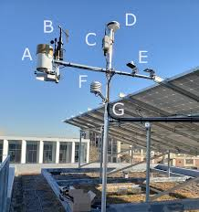
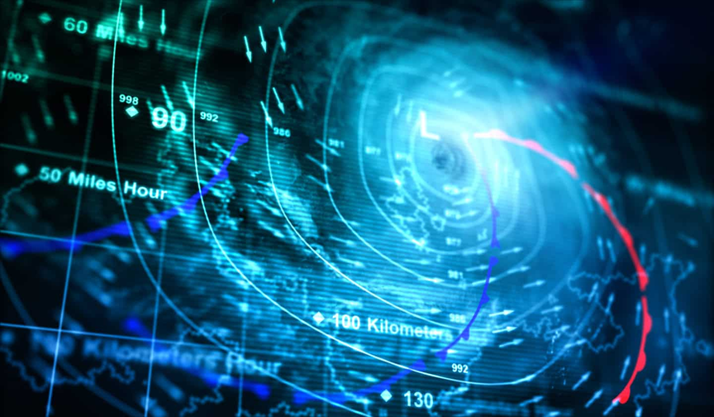
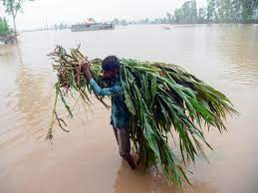
PROBLEMS
Limited Access to Hyper-Local Weather Data
Shortcomings in Current Technologies
Financial Losses and Resource Wastage

Slide 4
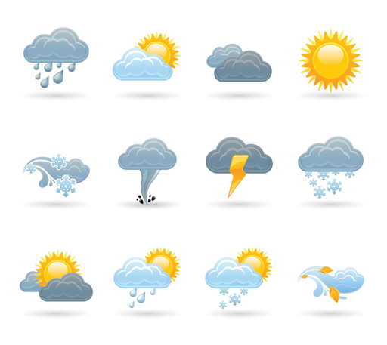

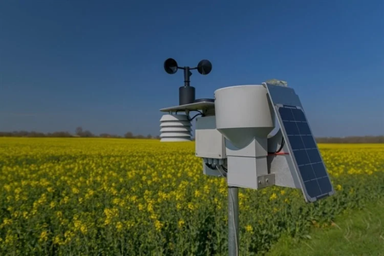

SOLUTION
MausamVibe
Harnessing dish TV signals for precise local weather forecasts without costly monitoring equipment, empowering informed decisions for individuals, businesses, and organizations.
EXCEPTIONAL ACCURACY
MausamVibe nodes, strategically placed, offer forecasts as close as 50 meters, surpassing competitors, and excelling in providing high-quality predictions for rural regions in India.
VERSATILE WEATHER MONITORING
Inspired by interactions with concerned farmers, MausamVibe employs hardware devices and machine learning to accurately forecast rain timing, revolutionizing agricultural planning and promoting sustainable practices.
REVOLUTIONIZING AGRICULTURE
By enhancing satellite data precision, MausamVibe becomes a valuable tool for various industries, addressing climate change concerns and offering actionable insights.

Slide 5
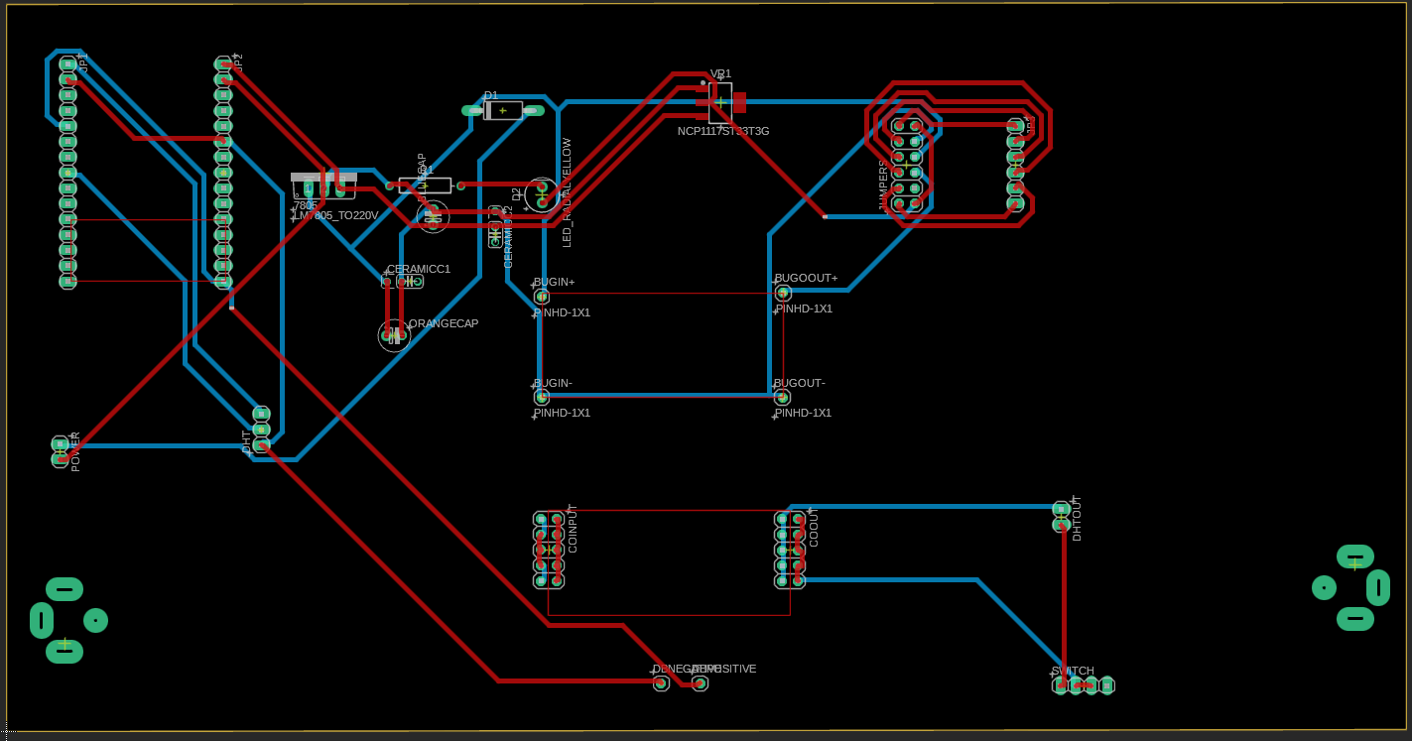
PCB DESIGN

Slide 6

UVP
Unique Value Proposition
Cost-Effective Solution
Hyper-Local Accuracy
Innovative Signal Analysis
Sustainability Impact

Slide 7
TARGETED
MARKET
Agriculture Industry
Businesses and Enterprises
Rural Communities
Government and Disaster Management Agencies
Environmental Organization
Research and Development

Slide 8


AgriTech
D2C
This adds value to farmers with
localized weather predictions.
Directly customer can be provided with a device at zero setup cost, and 1 month free trial for accurate weather predcitons
Subscription
We will offer subscription approach , by charging only for subscription .
Our
Strategy

Slide 9

Thank
You

